Slide 1
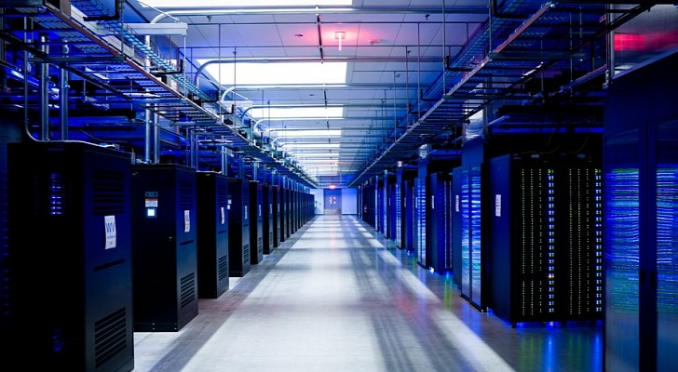

DL Workspace
Open Source Toolkit for Turn-Key AI Cluster (Introduction)
Notes:
We introduce DL Workspace, an open source toolkit for turn-key AI Cluster setup and operation.

Slide 2
DL Workspace is …
Open source toolkit for turn-key AI cluster setup
Used for daily development/production in Microsoft internal groups (e.g., Microsoft Cognitive Services, SwiftKey, Bing Relevance)
Allow AI scientist to run jobs (interactive exploration, training, inferencing, data analytics)
Resource managed by cluster
Turn-key operation (automatic software setup & cluster configuration)
Out-of-box support
All major DL toolkits (TensorFlow, CNTK, Caffe, MxNet, etc..)
Big data analytics (Hadoop/Spark)
Notes:
DL Workspace provides out-of-box support for multiple Deep Learning toolkit, and big data analytical kits. It is used daily by Microsoft employees, and allows AI scientist to run both interactive jobs and batch jobs on cluster.

Slide 3
WorkFlow
Notes:
The rest of the video explains the process to launch a Spark job.

Slide 4
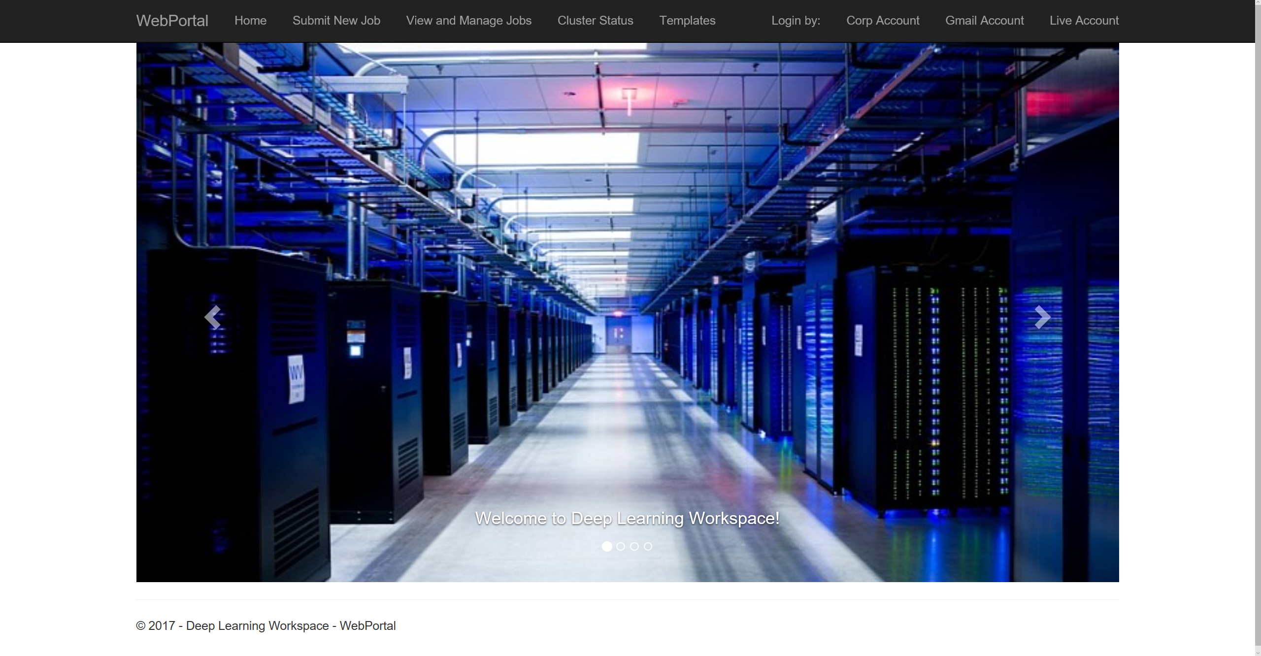
authentication via open id
Notes:
First, log in via your favorite provider through open id.

Slide 5
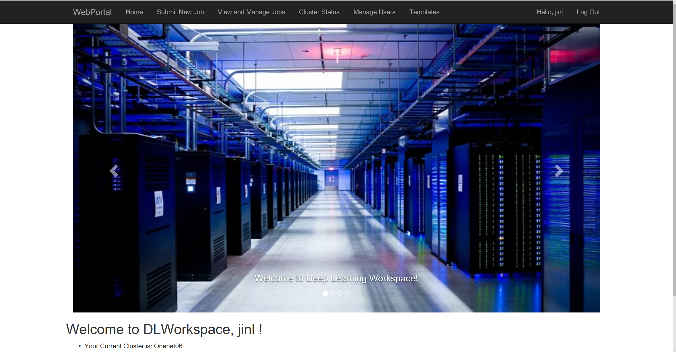
Select “Submit New Job”
once log in …
Notes:
Once log in, click “Submit New Job”

Slide 6
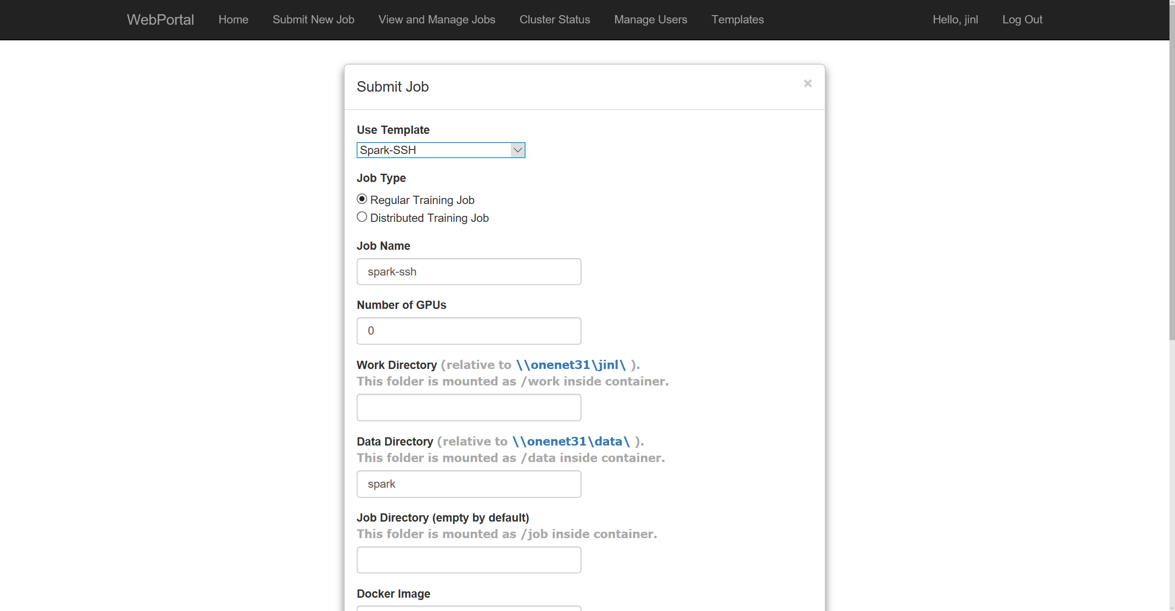
Select a template,
make optional modification
on job template
Notes:
Select a job template, and make optional adjustment.

Slide 7
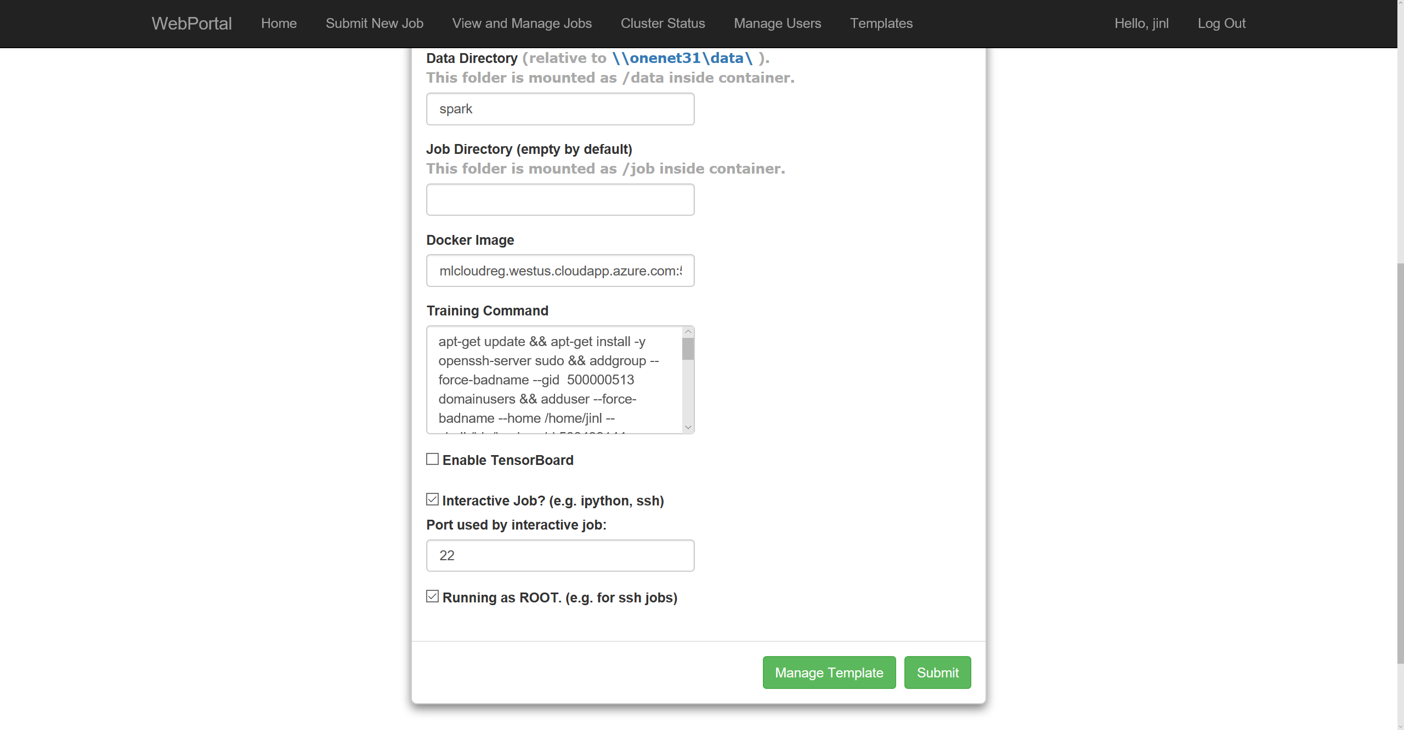
submit a job
Notes:
Click “Submit” button to schedule the job for execution.

Slide 8
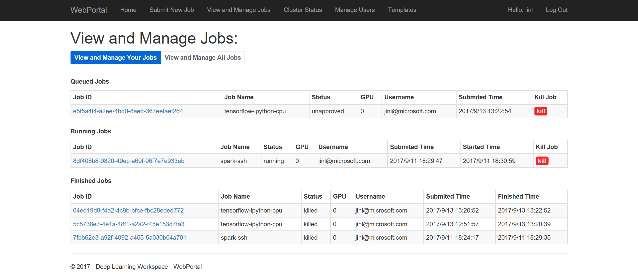
Select to view submitted jobs
Select Job ID
Notes:
Click “View and Manage Jobs”, and select proper job ID to monitor the jobs you have just executed.

Slide 9
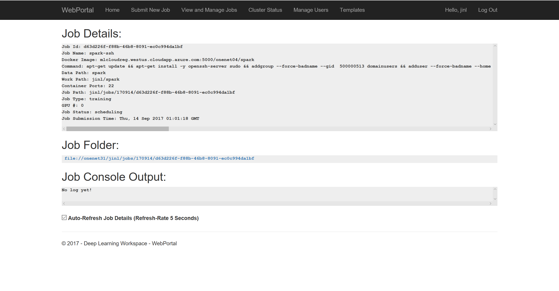
You may need to wait between a few seconds (execution of old job) to
several minutes (new job) for the job container to be scheduled, downloaded
and launched
Notes:
You may need to wait a few seconds to a few minutes for the job container to be scheduled, downloaded and launched.

Slide 10
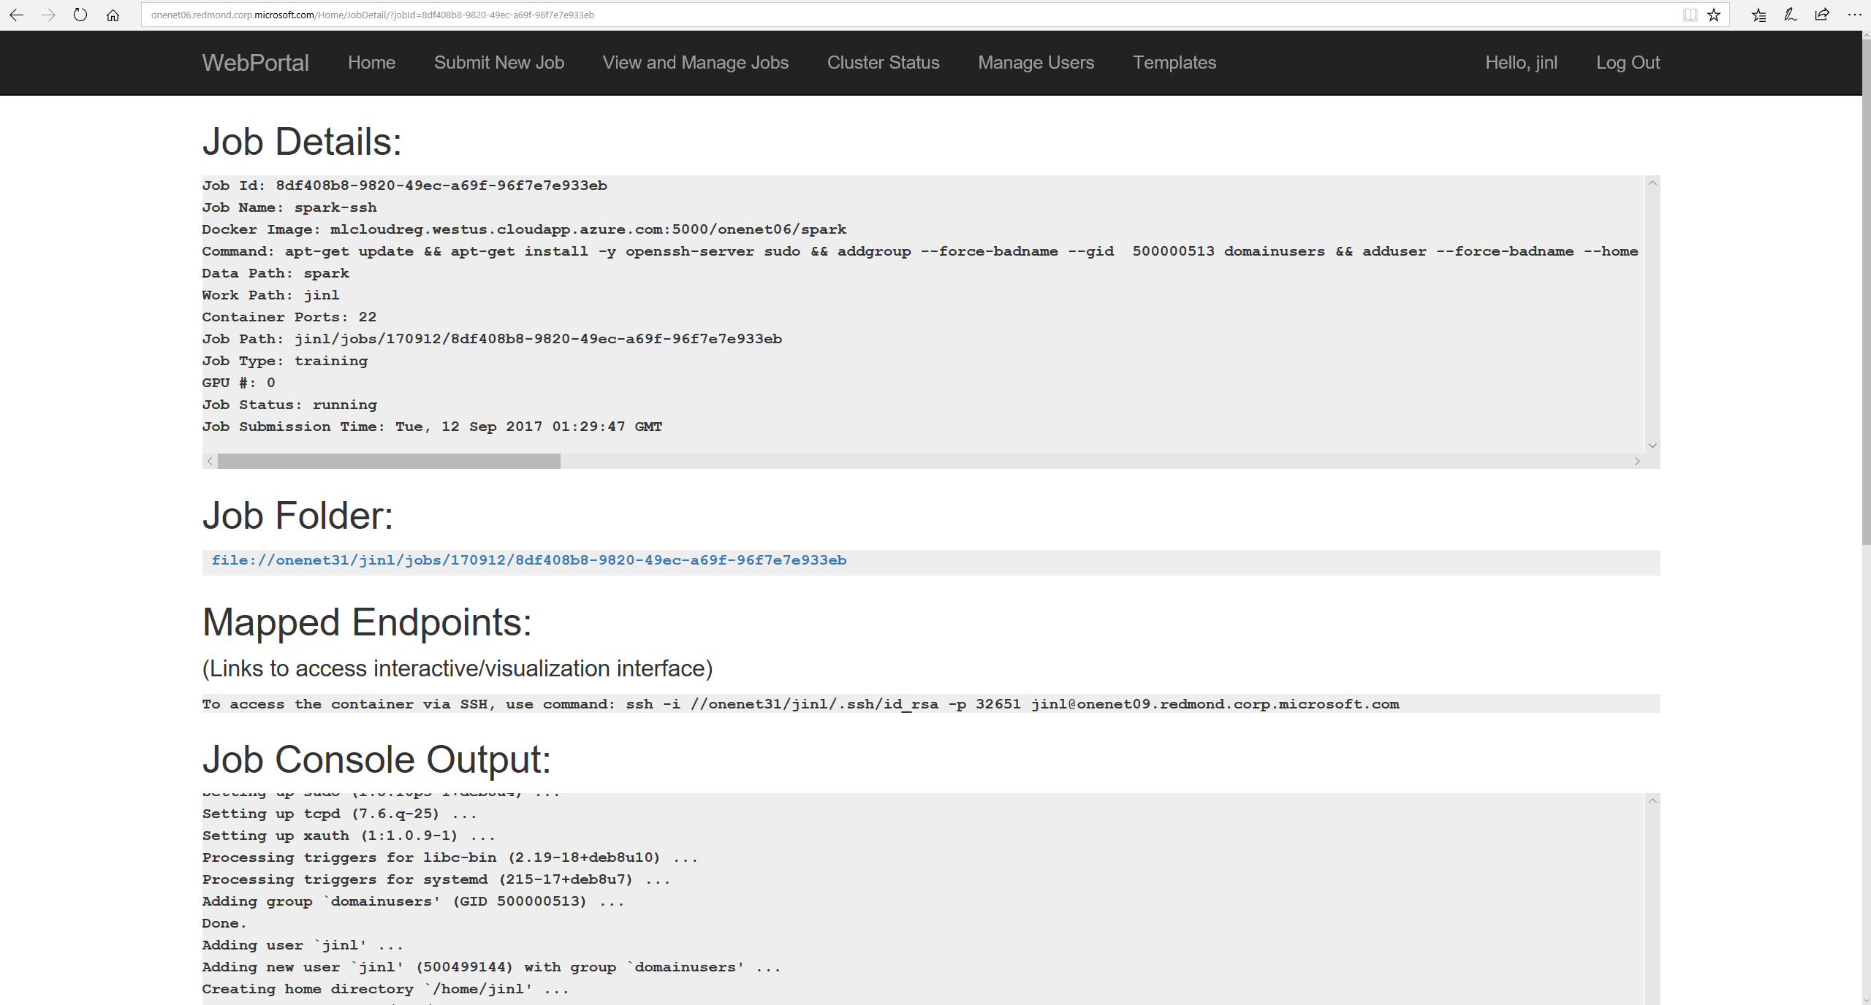
Wait for Mapped Endpoints to appear.
Notes:
Wait for “Mapped Endpoints” to appear.

Slide 11
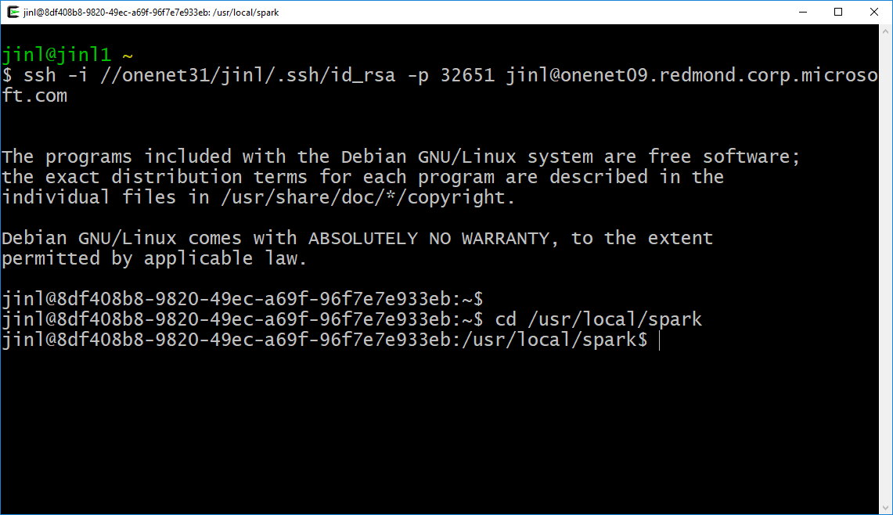
Execute ssh command to connect to the container
go to spark directory
Notes:
Run the ssh command shown in the endpoints. Go to spark directory.

Slide 12
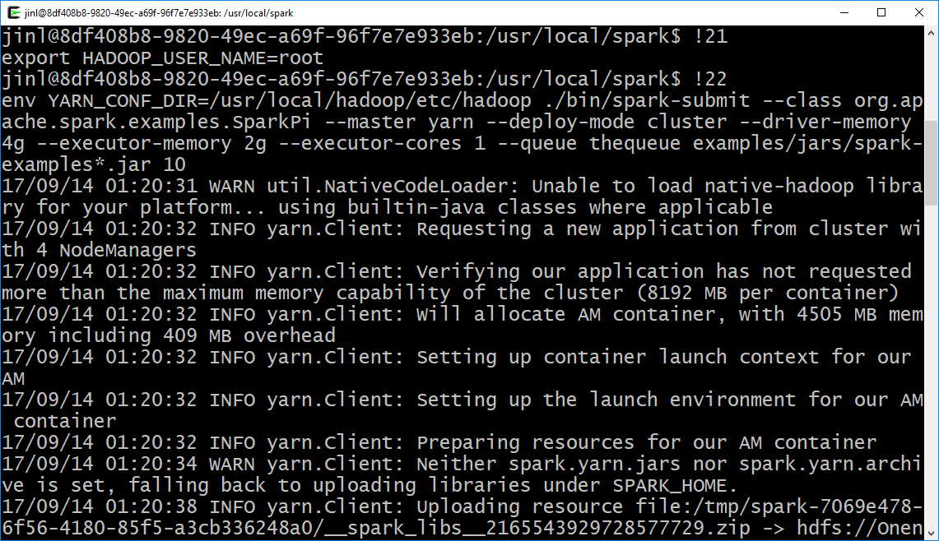
Execute spark command on cluster
Notes:
You may then execute a spark job against the DL workspace backend.

Slide 13
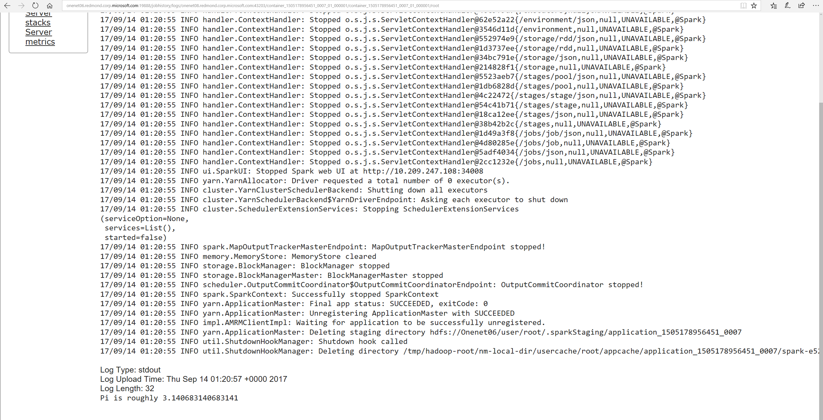
Here is the log & output of the executed spark job.
Notes:
You can monitor executed spark jobs through standard YARN portal.

Slide 14
DL Workspace provides …
Turn-key setup for AI cluster (in public cloud or on-perm)
Allow AI scientist to run jobs (interactive exploration, training, inferencing, data analytics) with fully setup software/hardware environment
Using DL Workspace, AI scientists can easily collaborate, and share job setup, and maximize job productivity
Notes:
DL Workspace provides turn-key setup for AI clusters, allow AI scientist to jump directly to work, and facilitate collaboration and sharing.

